Slide 1

Securing the server
Prepared by

Slide 2
Physical Security Methods and Concepts
Server Hardening Techniques

Slide 3
Physical Security Methods and Concepts
There are many logical security methods that can be used to protect the data on a server, if users can attain physical access to the server, the options available to them to compromise the server increase dramatically.
Multifactor Authentication:- There are three factors of authentication. When more than one of these factors is required to authenticate, it is called multifactor authentication. It is not multifactor if it uses two forms of the same factor of authentication.
Something You Have
Something You Know
Something You Are(Prone to False Positive and False Negative)

Slide 4
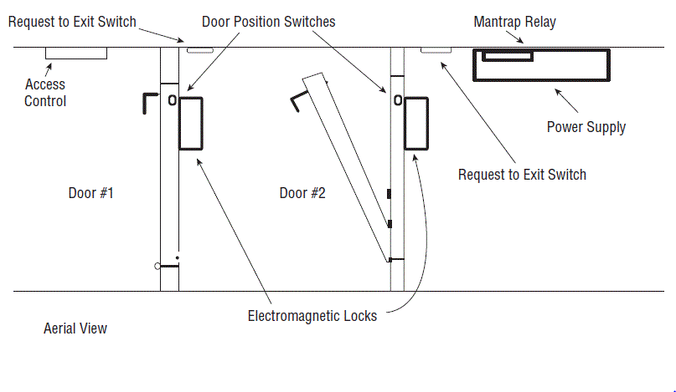
Security Concepts
A Mantrap is a series of two doors with a small room between them. The user is authenticated at the first door and then allowed into the room. At that point additional verification will occur (such as a guard visually identifying the person) and then the user is allowed through the second door. Mantraps also typically require that the first door is closed, prior to enabling the second door to open.

Slide 5
An increasingly popular method of tracking physical assets is to tag them with radio frequency identification (RFID) chips. This allows for tracking the location of the asset at any time.
The main components of this are
RFID Reader This device has an antenna and an interface to a computer.
Transponder This is the tag on the device that transmits its presence wirelessly.
The tags can be one of two types: passive and active.
Active tags have batteries whereas
passive tags receive their energy from the reader when the reader interrogates the device.

Slide 6
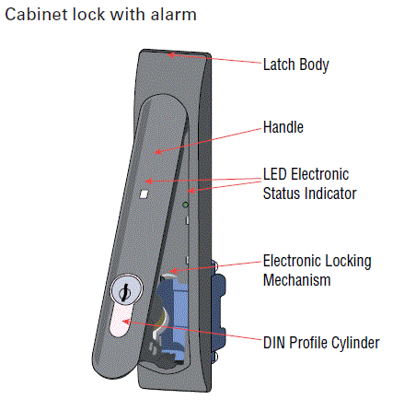
All users should possess and wear Identification Cards, but it becomes even more important when those users have access to the server room.
Biometric
Keypad
Access List
Security Guard
Security Camera
Key and Locks
Cabinet

Slide 7
Server Hardening Techniques
It involves hardening the system logically
—that is, hardening the operating system and applications
—and hardening the server physically by ensuring the device cannot be tampered with by someone who can touch the server

Slide 8
OS Hardening
Involves a series of steps that should result in a server that offers a minimum of attack points to a hacker.
Stopping Unneeded Services/Closing Unneeded Ports
The easiest way to do this is to install a host firewall on the system and adopt a “disable by default” policy with respect to services. Then manually enable any you need
Installing Only Required Software
You should examine all installed applications and retain only those you need.
Installing Latest Operating System Patches
Always keep the server updated with all operating system patches and service packs.

Slide 9
Implementing Application Hardening
Applications can have many features and embedded programs that you may not make use of. Determine which of these you require.
Installing Latest Patches
Applications can have many features and embedded programs that you may not make use of. Determine which of these you require.
Disabling Unneeded Services/Roles/Features

Slide 10
Endpoint Security
Therefore, the process of providing endpoint security is the process of ensuring that every endpoint (including servers) has been secured in the same way in which you would secure the network gateway.
There are two main issues to consider when providing endpoint security:
Identifying intrusions when they occur and preventing the spread of malware.
A host-based intrusion detection system (HIDS) is installed on the device (for the purpose of our discussion, a server) and the system focuses solely on identifying attacks on that device only.

Slide 11
These systems can use several methods of detecting intrusions.
Signature Based Analyzes traffic and compares patterns, called signatures, that reside within the IDS database. This means it requires constant updating of the signature database.
Anomaly Based Analyzes traffic and compares it to normal traffic to determine if the traffic is a threat. This means any traffic out of the ordinary will set off an alert.

Slide 12
There are drawbacks to these systems:
A high number of false positives can cause a lax attitude on the part of the security team.
Constant updating of signatures is needed.
A lag time exists between the release of the attack and the release of the signature.
An HIDS cannot address authentication issues.
Encrypted packets cannot be analyzed.
In some cases, IDS software is susceptible itself to attacks.

Slide 13
Hardware Hardening
Disabling Unneeded Hardware and Physical Ports/Devices
The closing of any software ports that are not in use is part of digital hardening, but the disabling of any physical ports or connections on the server is a part of physical hardening.
Some of the items that should be considered for disabling are
USB ports
NICs
Serial ports
Firmware ports

Slide 14
Disabling the Network Adaptor in Windows Server 2012 R2
1. Open the Server Manager tool if it is not already open.
2. From the Tools menu select Computer Management.
3. In the Computer Management
console select Device Manager.
4. Locate and expand the Network
Adaptors device category as
shown in fig

Slide 15
5. Right click the network adaptor you wish to disable (this server has only one, but your server may have more than one) and select Disable from the menu.
6. You can verify your work by looking for the black down arrow next to the adaptor as shown in Figure

Slide 16
BIOS Password
This can prevent someone with physical access to the server from booting to the BIOS, changing the boot order, and enabling a boot device for the purpose of booting to an external OS that they can use to take data off the hard drive.

Slide 17
Which authentication mechanism is an example of something you have?
A. Password
B. Username
C. Smart card
D. Retina scan

Slide 18
Which authentication mechanism is an example of something you have?
A. Password
B. Username
C. Smart card
D. Retina scan

Slide 19
Which of the following is not a drawback of using active RFID chips?
A. The tag signal can be read by any reader in range.
B. The tag signal can only go a few feet.
C. Multiple readers in an area can interfere with one another.
D. Multiple devices can interfere with one another when responding.

Slide 20
Which of the following is not a drawback of using active RFID chips?
A. The tag signal can be read by any reader in range.
B. The tag signal can only go a few feet.
C. Multiple readers in an area can interfere with one another.
D. Multiple devices can interfere with one another when responding.

Slide 21
Which of the following is not true of an HIDS?
A. A high number of false positives can cause a lax attitude on the part of the security team.
B. An HIDS cannot address authentication issues.
C. Encrypted packets cannot be analyzed.
D. An HIDS monitors all traffic that goes through it looking for signs of attack on any machine in the network.

Slide 22
Which of the following is not true of an HIDS?
A. A high number of false positives can cause a lax attitude on the part of the security team.
B. An HIDS cannot address authentication issues.
C. Encrypted packets cannot be analyzed.
D. An HIDS monitors all traffic that goes through it looking for signs of attack on any machine in the network.

Slide 23
Which of the following is not an example of physical hardening of the server?
A. Disabling USB ports
B. Implementing strong authentication to log into the server
C. Installing locks on server racks
D. Installing locks on the server room door

Slide 24
Which of the following is not an example of physical hardening of the server?
A. Disabling USB ports
B. Implementing strong authentication to log into the server
C. Installing locks on server racks
D. Installing locks on the server room door

Slide 25
Basic Network Security Systems and Protocols
Firewall are used to filter out unwanted traffic while allowing desired traffic.
Network-Based firewalls are one of the first lines of defence in a network. There are different types of firewalls, and they can either be standalone systems or they can be included in other devices such as routers or servers.
Firewalls function as one or more of the following:
■ Packet filter
■ Proxy firewall
■ Stateful inspection firewall

Slide 26
Packet Filter Firewalls A firewall operating as a packet filter passes or blocks traffic to specific addresses based on the type of application. The packet filter doesn’t analyze the data of a packet; it decides whether to pass it based on the packet’s addressing information.
A Proxy firewall can be thought of as an intermediary between your network and any other network. Proxy firewalls are used to process requests from an outside network and those outbound from inside the network.(This Process includes hiding IP addresses).
Stateful inspection is also referred to as stateful packet filtering. Most of the devices used in networks don’t keep track of how information is routed or used.

Slide 27
How Firewall Works
Firewall match the network traffic against the rule set defined in its table. Once the rule is matched, associate action is applied to the network traffic. For example, Rules are defined as any employee from HR department cannot access the data from code server and at the same time another rule is defined like system administrator can access the data from both HR and technical department. Rules can be defined on the firewall based on the necessity and security policies of the organization.

Slide 28
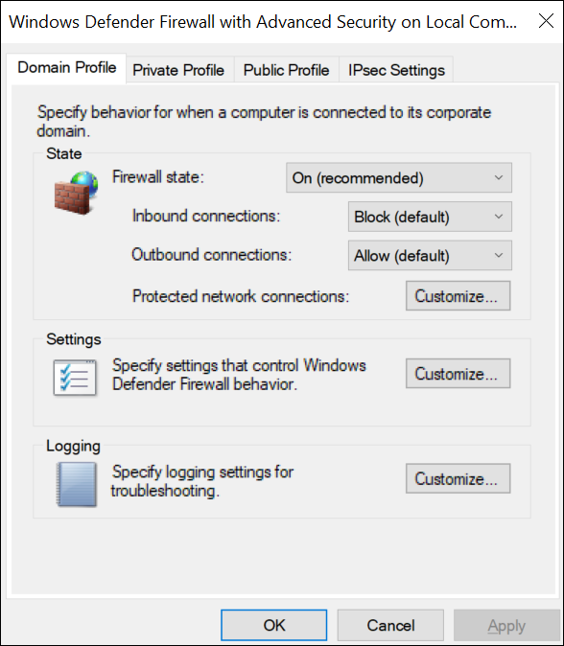
Configure Security Protocols
Procedure
Run wf.msc.
The Windows Defender Firewall with Advanced Security window appears.
Create a security method:
Select Actions > Properties.
The Windows Defender Firewall with Advanced Security on Local Computer window appears.

Slide 29
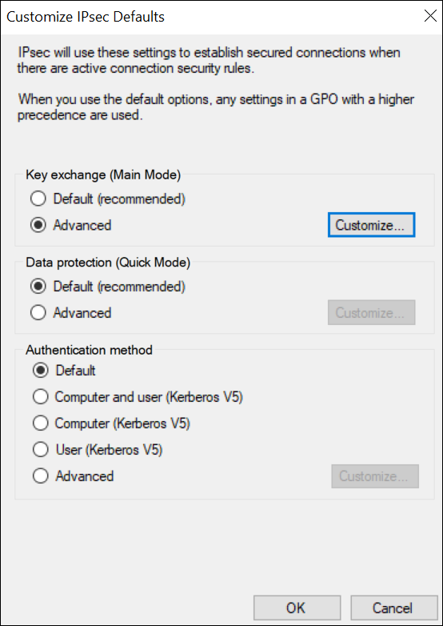
b. Select IPsec Settings > Customize.
The IPsec Defaults window appears.

Slide 30
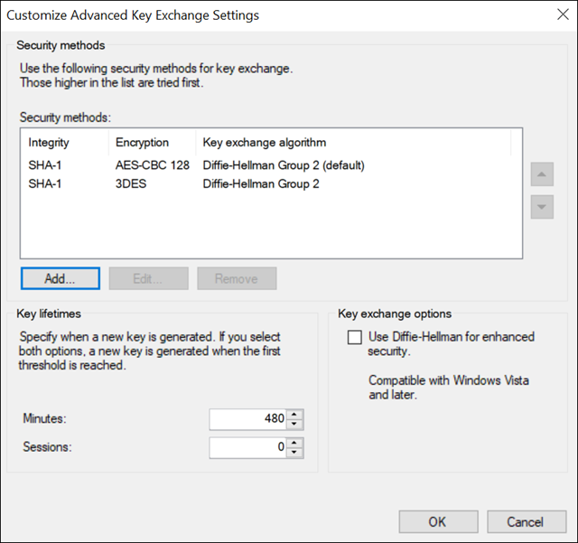
c. Under Key exchange (Main Mode), select Advanced > Customize.
The Customize Advanced Key Exchange Settings window appears.

Slide 31
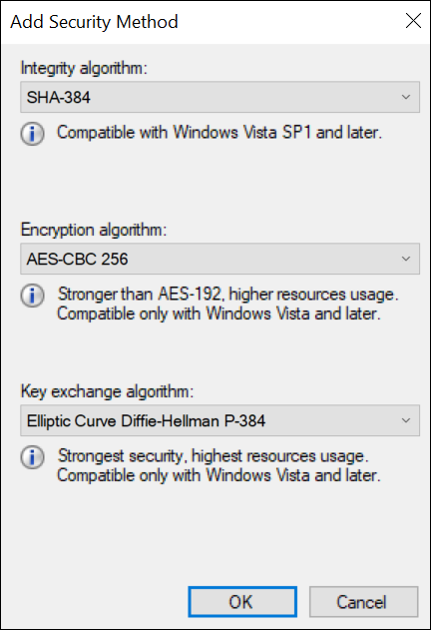
d. Select Add.The Add Security Method window appears.
e. Select the algorithms that you want to use for each purpose. The following image shows an example.

Slide 32
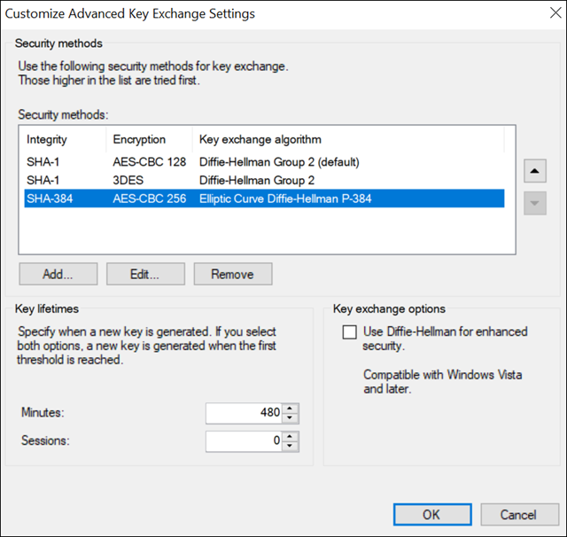
The security method that you have added appears in the list.

Slide 33
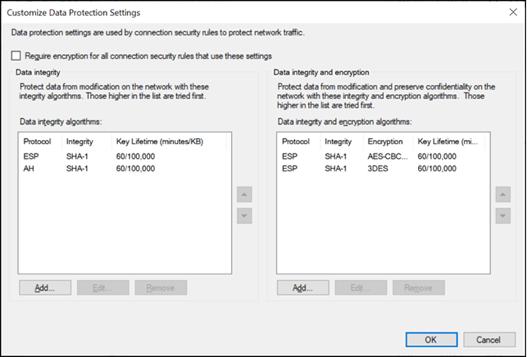
f. Move the security method that you have added to the top of the list. We recommend that you remove the other methods.
g. Select OK.
3. Add integrity and encryption algorithms:
In the Customize IPsec Defaults window, under Data protection (Quick Mode), select Advanced > Customize.
The Customize Data Protection Settings window appears.

Slide 34
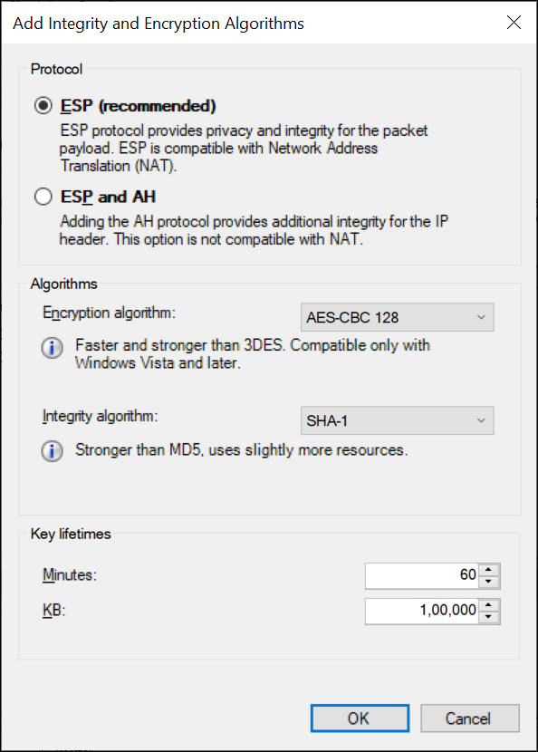
b. Select the Require encryption for all connection and security rules that use these settings check box.
c. Under Data integrity and encryption, select Add.The Add Integrity and Encryption Algorithms window appears.

Slide 35
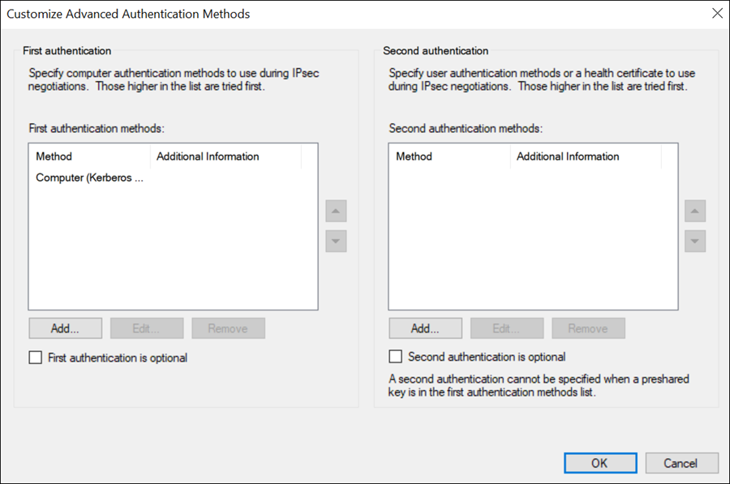
d. Under Protocol, ensure that ESP is selected.
e. Select the algorithms that you want to use for each purpose, and then select OK.
The algorithms that you have selected appear in the list.
f. Move the algorithms to the top of the list. We recommend that you remove the remaining items in the list.
g. Select OK.
4. Create a first authentication method:
In the Customize IPsec Defaults window, under Authentication Method, select Advanced > Customize.
The Customize Advanced Authentication Methods window appears.

Slide 36
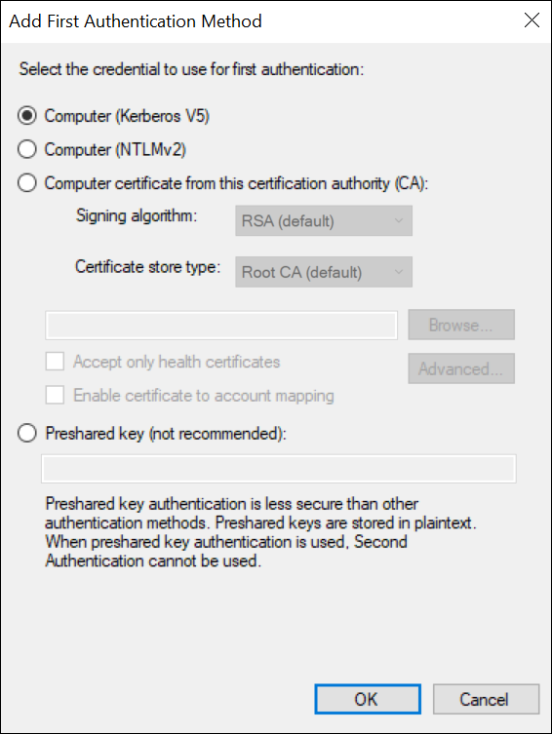
b. Under First authentication methods, select Add.The Add First Authentication Method window appears.

Slide 37
c. Provide the CA certificate that you want to use, and then select OK. The certificate that you have provided appears in the list.
d. Move the certificate to the top of the list. We recommend that you remove the remaining items in the list.
e. Select OK.

Slide 38
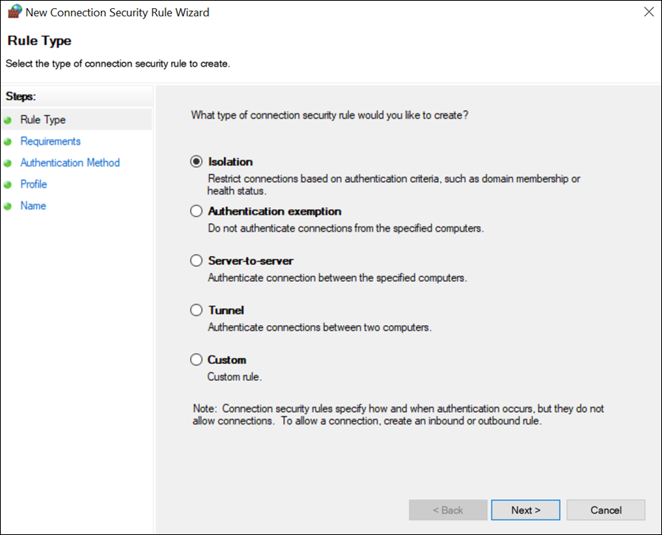
5. Create a connection security rule:
For Windows x86, run the following set of commands to create a rule:
netsh advfirewall
consec
add rule name=""<rule name>"" endpoint1=any endpoint2=any protocol=tcp port1=any port2=2010
action=requestinrequestout
For other versions, perform the following steps:
In the Windows Defender Firewall with Advanced Security window, select Connection Security Rules.
Select Actions > New Rule.
The New Connection Security Rule Wizard window appears.

Slide 39
c. Select Custom, and then select Next.
d. Both for Endpoint 1 and Endpoint 2, select Any IP Address, and then select Next.
e. Select Require authentication for inbound and outbound connections, and then select Next.
f. Select Default, and then select Next.
g. Enter values as described in the following table, and then select Next.
Field | Description
Protocol type | Select TCP.
Endpoint 1 port | Select All Ports.
Endpoint 2 port | Select Specific Ports, and then enter 2010.
h. Select when to apply the rule, and then select Next.
i. Enter a name and description for the rule, and then select Finish.The rule appears in the Connection Security Rules window.
j. Ensure that the rule is enabled.

Slide 40
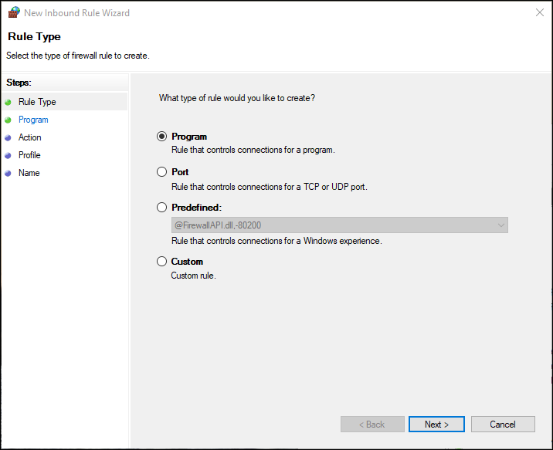
6. If using Microsoft Windows Server 2019, 2016, 2012 R2 and/or Windows 8, 8.1, open up port number 5000:
In the Windows Defender Firewall with Advanced Security window, select Inbound Rules.
Select Actions > New Rule.
The New Inbound Rule Wizard window appears.

Slide 41
c. Select Custom, and then select Next.
d. Select All programs, and then select Next.
e. Enter values as described in the following table, and then select Next.
Field | Description
Protocol type | Select UDP.
Protocol number | Leave the default value as is.
Local port | Select Specific Ports, and then enter 5000.
Remote port | Leave the default value as is.
f. Both for the local and remote IP addresses, set the scope to Any IP address, and then select Next.
g. Select Allow the connection, and then select Next.
h. Select when to apply the rule, and then select Next.
i. Enter a name and description for the rule, and then select Finish.The rule appears in the Inbound Rules window.
j. Ensure that the rule is enabled.
IPSEC is now configured on the machine.

Slide 42
7. Repeat all the steps above on all the machines that host the Historian server and/or its components/clients.
8. To verify that the IPSEC cryptography is used:
Ensure that the Historian server is running.
Ensure that the collectors are connected to the Historian server, and that the collectors are running.
Specify the tags for data collection. You can do so using Configuration Hub or Historian Administrator.
Verify that the collector is collected data.
On each machine on which you configured IPSEC, run wf.msc.
The Windows Defender Firewall with Advanced Security window appears.
Select Monitoring > Security Associations > Main Mode.
The Main Mode section displays the connection that you have created.

Slide 43
Router Access List
firewalls can be used to keep unwanted and perhaps malicious traffic types out of the network, and port security and NAC can help keep intruders out of the network, within the network there will be occasions when you don’t want to allow communication between certain devices.
In these scenarios, you can use access control lists (ACLs) on the router.
The inherent limitation of ACLs is their inability to detect whether IP spoofing is occurring.

Slide 44
NIDS
A network-based IDS (NIDS) monitors network traffic on a local network segment. This is in contrast to a host-based IDS (HIDS) that monitors a single machine.
One of the disadvantages of an NIDS (which is an advantage of an HIDS) is that it cannot monitor any internal activity that occurs within a system, such as an attack against a system that is carried out by logging on to the system’s local terminal.

Slide 45
Network Access Control
Access of users to the network both locally and remotely should be strictly controlled. This can be done at a number of levels of the OSI model, and it can be accomplished in a decentralized or centralized manner:-
Port Security
802.1x
NAC

Slide 46
Port Security
Port security applies to ports on a switch, and since it relies on monitoring the MAC addresses of the devices attached to the switch ports, we call it Layer 2 security.
There are several things you can accomplish with port security. It can be used to
Set the maximum number of MAC addresses that can be seen on a port.
Define exactly which MAC addresses are allowed on the port.
Take a specific action when a port violation occurs.

Slide 47
802.1x
The IEEE 802.1x security standard describes a method of centralizing the authentication, authorization, and accounting of users that connect either locally or remotely to the network.
It is sometimes called port-based access control because in an 802.1x architecture, the user’s port to the network is not opened until the processs is complete.
The 802.1x architecture can be applied to both wireless and wired networks and uses three components:
Supplicant The user or device requesting access to the network
Authenticator The device through which the supplicant is attempting to access the network
Authentication Server The centralized device that performs authentication

Slide 48
NAC
Network Access Control (NAC) is a service that goes beyond authentication of the user. NAC includes an examination of the state of the computer the user is introducing to the network when making a remote access or VPN connection to the network.
These services are called Network Access Protection(NAP) in Microsoft world. The goal to examine all the devices requesting network access for malware, missing security updates any other security issues the device could potentially introduce to network.
The health state of the device requesting access is collected and sent to the Network Policy Server (NPS), where the state is compared to requirements. If requirements are met, access is granted and if requirements are not met access is usually limited or denied.

Slide 49
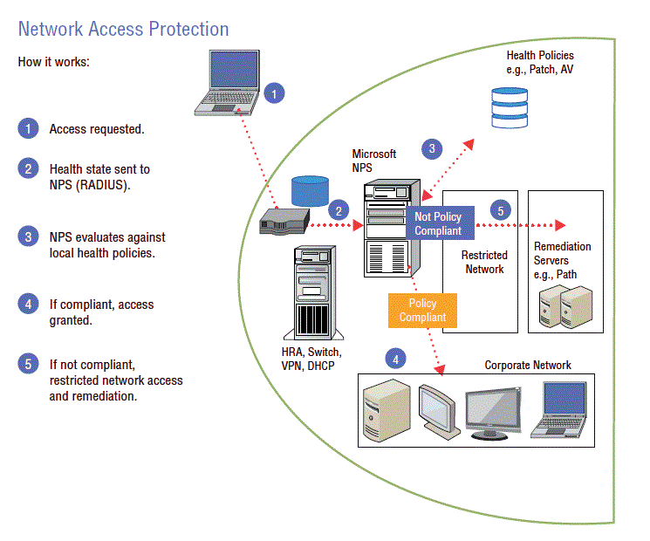

Slide 50
Router Access List
If you want to prevent users in the Sales subnet from accessing data in the Finance subnet. In these scenarios, you can use access control lists (ACLs) on the router.
The inherent limitation of ACLs is their inability to detect whether is occurring. IP spoofing
The hacker alters the IP address as it appears in the packet. This can sometimes allow the packet to get through an ACL that is based on IP addresses.
It also can be used to make a connection to a system that only trusts certain IP addresses or ranges of IP addresses.

Slide 51
NIDS
A network-based IDS (NIDS) monitors network traffic on a local network segment. This is in contrast to a host-based IDS (HIDS) that monitors a single machine.
One of the disadvantages of an NIDS (which is an advantage of an HIDS) is that it cannot monitor any internal activity that occurs within a system, such as an attack against a system that is carried out by logging on to the system’s local terminal.

Slide 52
PKI
A public key infrastructure (PKI) includes systems, software, and communication protocols that distribute, manage, and control public key cryptography.
Users and devices are issued public/private key pairs that are bound to a digital document called a digital certificate. This certificate (more specifically, the keys to which it is bound) can be used for a variety of things, including:-
Encrypting Data
Authenticating Users and Devices
Encrypting Email
Digitally Signing Softwares

Slide 53
VPN
Virtual private network (VPN) connections are remote access connections that allow users to securely connect to the enterprise network and work as if they were in the office.
These connections use special tunneling protocols that encrypt the information being transferred between the user and the corporate network.
■ Point-to-Point Tunneling Protocol (PPTP)
■ Layer 2 Tunneling Protocol (L2TP)

Slide 54
VLAN
Virtual local area networks (VLANs) are logical subdivisions of a switch that segregate ports from one another as if they were in different LANs.
For example, if only one device should be able to connect to the Finance server, the device and the Finance server could be placed in a VLAN separate from the other VLANs.

Slide 55
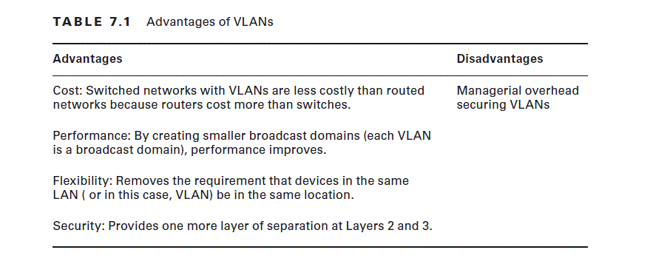

Slide 56
Create an OU of LPU including OU:
Punjab
Delhi
task1) under these OU's create security groups:
Adminitrator
task2) under these OU's create Distribution groups:
Students
Faculty
task3)under each group add atleast 3 users.
task4) For both OU's define given policies:-
1)user account lockout policy
2)user authentication Policy using kerberos
2)logon locally policy(both allow and deny login)

Slide 57
Thank you

